Slide 1
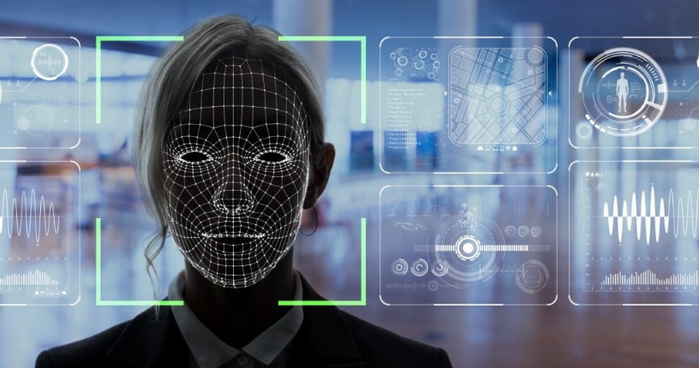
Facial Image Recognition using CRI-AI Thermal Cameras
Image Source: https://ngscinc.com/access-control-trends-for-2021-facial-recognition/

Slide 2
Content
Project Summary
Team Profile
Project Progress update
Individual Status Report
High-Level Timeline Chart (GANTT)
Plans for the next weekly status report

Slide 3
Project Summary
Purpose of this project is to develop a model a facial recognition system using CRI- AI Thermal cameras. CRI stands for Color Rendering Index and is nothing but a specification of cameras which states how accurately artificial light shows colors of the people under them.
Facial Recognition is the process of identifying a person through his or her facial features. We will be using thermal cameras to detect human faces. When we think about thermal images in the context of people, what usually comes to mind is night vision. The ability to see a person, or group of people, by the inevitable heat their bodies emit.
An important aspect of our project requires us to understand that thermal images capture heat in the form of frequency of pixels, varying from 0 to 1. Studies have found that each face emits a unique heat signature due to the blood vessels below the skin, as mentioned by Barclay (2013). Therefore, thermal facial images capture unique individual facial heat signatures which mark as unique biomarkers, providing us with rich information to classify a person correctly using a model.

Slide 4
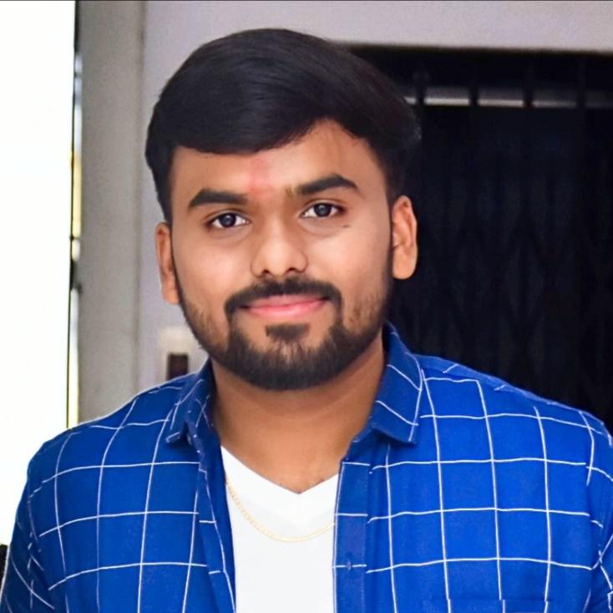
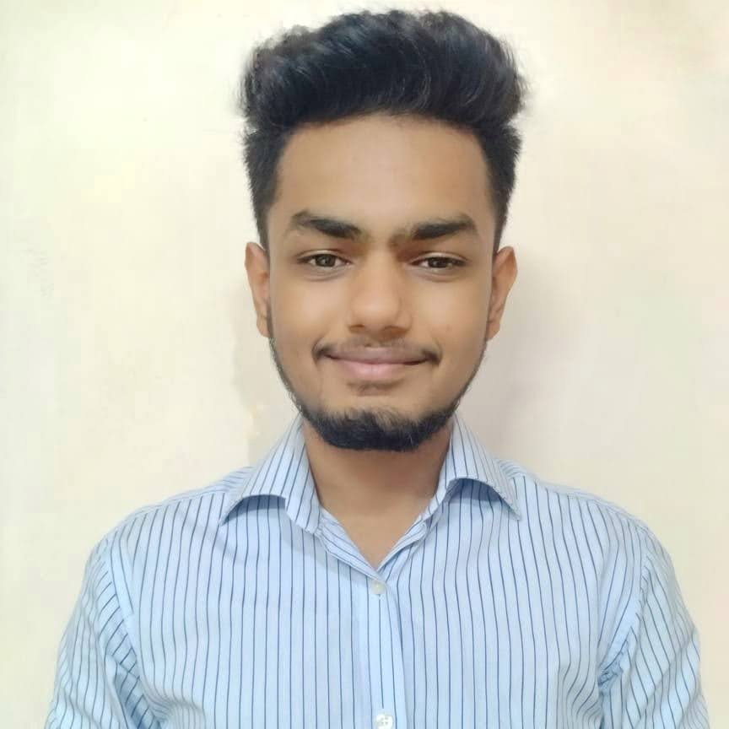

Team Profile
Kishan Patel
(B.Sc. Physics, PGDCA, Big Data Solution Architecture)
A Big Data Analyst having non-cs bachelor degree, yet significantly interested, and competent in AI industry.
Tilak Pandya
(BCA, MCA)
A developer who explores concepts and potential in the tech industry.
Namrakumar Patel
(B.E. Computer Science)
A developer with real-world problem solving experience and a desire for innovation.

Slide 5
Project Progress Update
Worked on face detection.
Used webcam as a source of images.
Identified various libraries which can be used for computer vision.
Finalized OpenCV library.
Facial Detection and Confidence rate detection.
Presentation.

Slide 6
Individual Status Report
Tilak and Namra:
Explored various libraries that supports computer vision. (OpenCV, Scikit-images, SimpleCV, Pillow,…)
Finalized OpenCV because of…
Large Community
Wide Range of functions
Platform Independent
Performance
Interpretability
Kishan:
Explored alternatives of CRI AI cameras to integrate the model. i.e. Webcam, Smartphone camera, DSLR, etc…)
Presentation

Slide 7
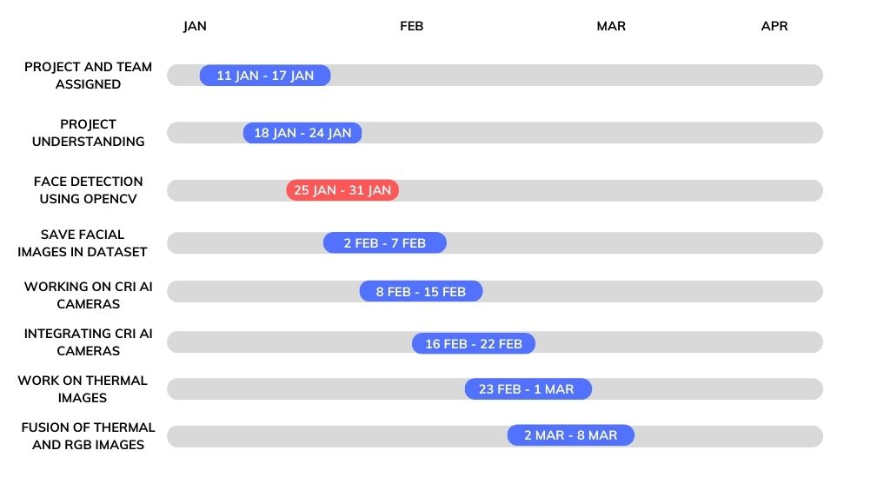
High-Level Timeline Chart (GANTT)

Slide 8
Now Onwards …
Save multiple images of faces in dataset.
Convert images in such a way that the model captures the detailed information of the picture.
Work upon Image Segmentation.
Start working on Thermal images.

Slide 9
Thank you!

